Slide 1
Implementing CycleGAN for Unpaired Image-to-Image Translation
Paritosh Kumar Velalam(pvelalam(50295537))
Sampreeth Reddy B(sboddire(50298591))
Deepak Sreenivasa(deepaksr(50292708))

Slide 2
Introduction
CycleGAN is a technique for training unsupervised image translation models via the GAN architecture using unpaired collections of images from two different domains.
CycleGAN has been demonstrated on a range of applications including season translation, object transfiguration, style transfer, and generating photos from paintings.
CycleGAN is an extension of the GAN architecture that involves the simultaneous training of two generator models and two discriminator models.
CycleGAN is extremely usable because it doesn’t need paired data. It’s often pretty difficult to get a large amount of accurate paired data, and so the ability to use unpaired data with high accuracy means that people without access to sophisticated (and expensive) paired data can still do image-to-image translation.

Slide 3
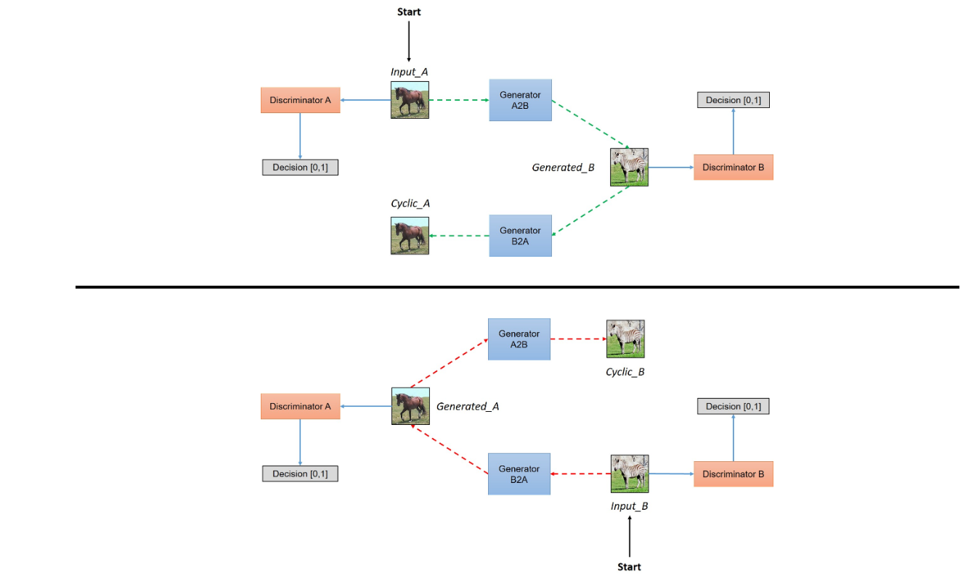
Network Architecture

Slide 4
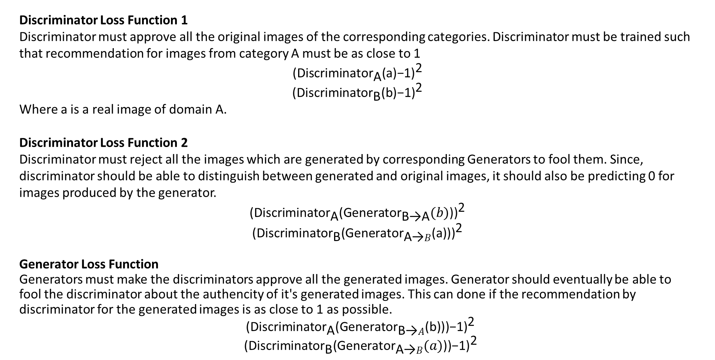
Loss Function Associated with CycleGAN
Discriminator Loss Function 1
Discriminator must approve all the original images of the corresponding categories. Discriminator must be trained such that recommendation for images from category A must be as close to 1
$${\text{(}{\text{Discriminator}}_{\text{A}}\text{(}\text{a}\text{)−1)}}^{\text{2}}$$
$${\text{(}{\text{Discriminator}}_{\text{B}}\text{(}\text{b}\text{)−1)}}^{\text{2}}$$
Where a is a real image of domain A.
Discriminator Loss Function 2
Discriminator must reject all the images which are generated by corresponding Generators to fool them. Since, discriminator should be able to distinguish between generated and original images, it should also be predicting 0 for images produced by the generator.
$${\text{(}{\text{Discriminator}}_{\text{A}}\text{(}{\text{Generator}}_{\text{B}\text{→}\text{A}}(b)\text{))}}^{\text{2}}$$
$${\text{(}{\text{Discriminator}}_{\text{B}}\text{(}{\text{Generator}}_{\text{A}\text{→}B}\text{(}\text{a}\text{)))}}^{\text{2}}$$
Generator Loss Function
Generators must make the discriminators approve all the generated images. Generator should eventually be able to fool the discriminator about the authencity of it's generated images. This can done if the recommendation by discriminator for the generated images is as close to 1 as possible.
${\text{(}{\text{Discriminator}}_{\text{A}}\text{(}{\text{Generator}}_{\text{B}\text{→}A}\text{(}\text{b}\text{)))−1}\text{)}}^{\text{2}}$
${\text{(}{\text{Discriminator}}_{\text{B}}\text{(}{\text{Generator}}_{\text{A}\text{→}B}(a)\text{))−1)}}^{\text{2}}$

Slide 5
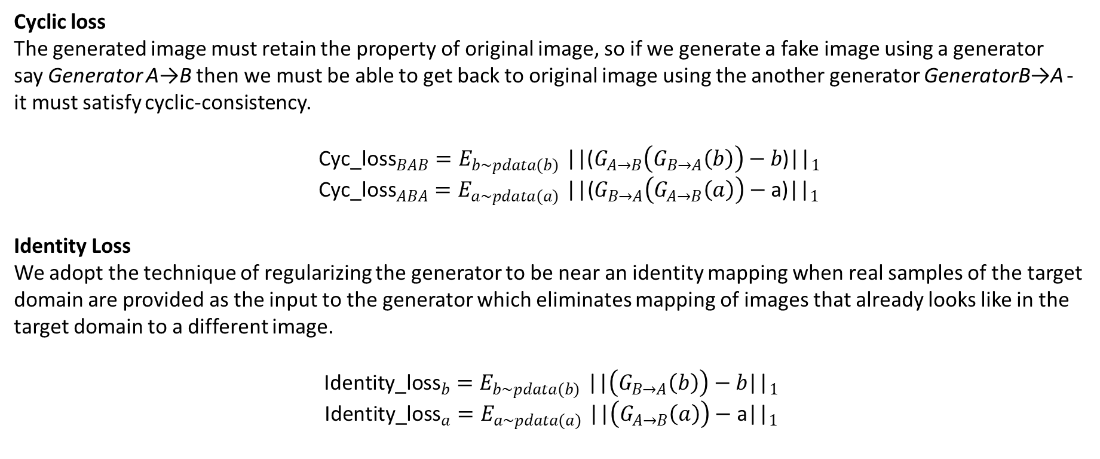
Cyclic loss
The generated image must retain the property of original image, so if we generate a fake image using a generator say Generator A→B then we must be able to get back to original image using the another generator GeneratorB→A - it must satisfy cyclic-consistency.
${\text{Cyc}\text{_}\text{loss}}_{BAB}{=E}_{b\sim pdata(b)}{\text{||(}G_{A→B}\left(G_{B→A}\left(b\right)\right)−b\text{)||}}_{1}$
${\text{Cyc}\text{_}\text{loss}}_{ABA}{=E}_{a\sim pdata(a)}{\text{||(}G_{B→A}\left(G_{A→B}\left(a\right)\right)−\text{a}\text{)||}}_{1}$
Identity Loss
We adopt the technique of regularizing the generator to be near an identity mapping when real samples of the target domain are provided as the input to the generator which eliminates mapping of images that already looks like in the target domain to a different image.
$${\text{Identity}\text{_}\text{loss}}_{b}{=E}_{b\sim pdata(b)}{\text{||}\left(G_{B→A}\left(b\right)\right)−b\text{||}}_{1}$$
$${\text{Identity}\text{_}\text{loss}}_{a}{=E}_{a\sim pdata(a)}{\text{||}\left(G_{A→B}\left(a\right)\right)−\text{a}\text{||}}_{1}$$
Dataset: https://people.eecs.berkeley.edu/~taesung_park/CycleGAN/datasets/ (monet2photo, vangogh2photo, ukiyoe2photo, cezanne2photo)

Slide 6
Generator
Discriminator
Input Image (128 x 128 x 3)
3, 7x7, 64
ResNet Block
Batch Norm + Relu
3, 4x4, 64
64, 3x3, 128
Leaky Relu (0.2)
Batch Norm + Relu
256, 3x3, 256
64, 4x4, 128
128, 3x3, 256
Batch Norm + Relu
Batch Norm + Leaky Relu (0.2)
Batch Norm + Relu
128, 4x4, 256
256, 3x3, 256
6 ResNet blocks
Batch Norm + Leaky Relu (0.2)
Relu
256, 4x4, 512
Batch Norm + Relu
+
Batch Norm + Leaky Relu (0.2)
256, 3x3, 128
Batch Norm + Relu
512, 4x4, 512
128, 3x3, 64
Batch Norm + Leaky Relu (0.2)
Batch Norm + Relu
512, 4x4, 1
64, 7x7, 3
Output (8 x 8 x 1)
Output Image (128 x 128 x 3)

Slide 7
Data Preprocessing:
Resizing images of 256x256 to 143x143
Random Cropping of 143x143 image to get 128x128 image
Randomly flipping the 128x128 image along vertical axis
Hyperparameters:
Batchsize = 1
Cycle loss weight = 10
Identity loss weight = 5
Learning Rate Generator = 0.0002
Learning Rate Discriminator = 0.0002
Techniques used to avoid Mode Collapse:
Instead of passing the current fake image generated by the Generator for Discriminator training on fake images, fake image from the past 50 fake images generated by generator is randomly chosen and passed to the Discriminator for its training

Slide 8
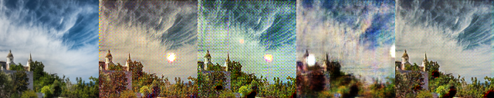
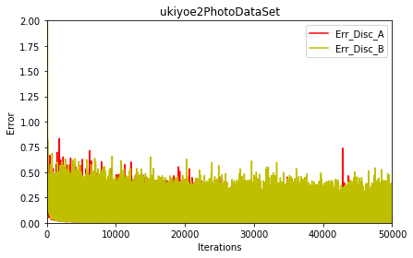
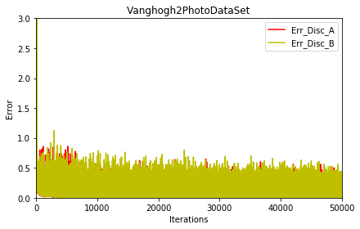
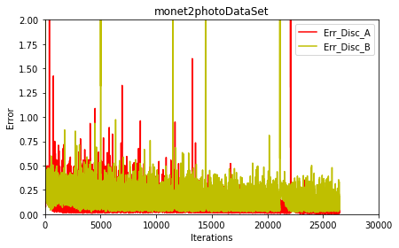
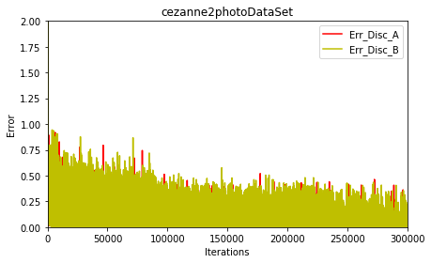
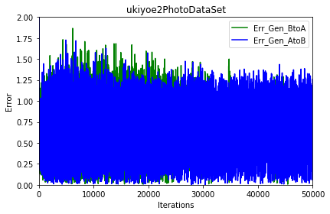
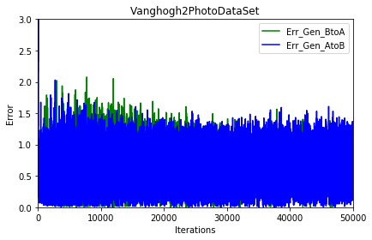
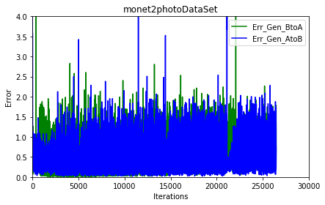
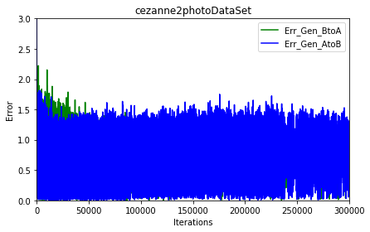
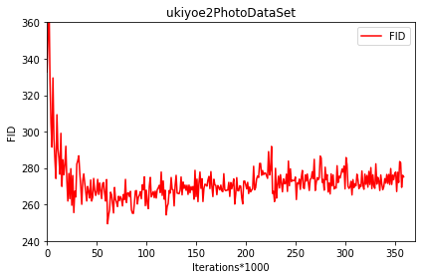
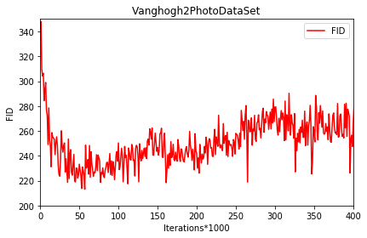
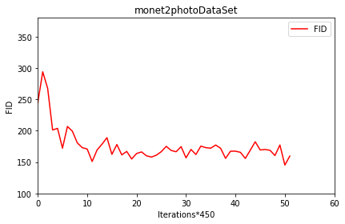
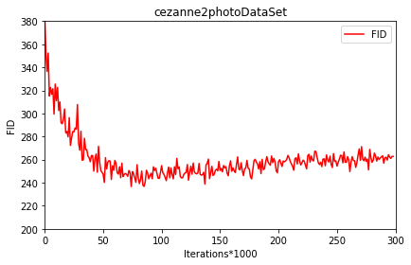
Results
real image Ukiyoe image Vangogh Image Monet image Cezanne Image
Discriminators loss curve
Generators loss curve
FID curve

Slide 9
Changes to Discriminator:
Spectral Normalization is applied to all Convolution layers
Self Attention with feature map 16x16 has been added after second layer
Changes to Generator:
Spectral Normalization is applied to all Convolution layer
Hyperparameters:
Batchsize = 16
Cycle loss weight = 10
Identity loss weight = 5
Learning Rate Generator = 0.0002
Learning Rate Discriminator = 0.0002

Slide 10
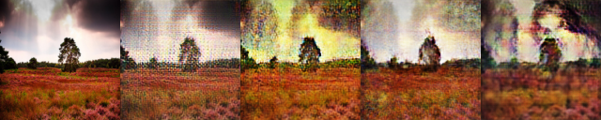
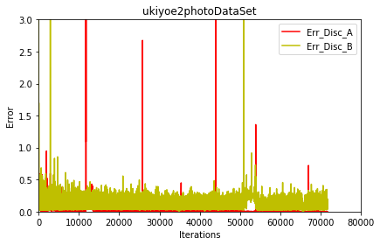
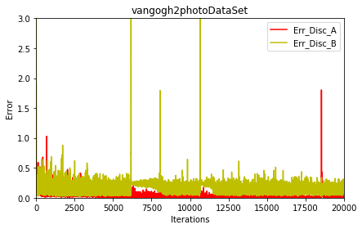
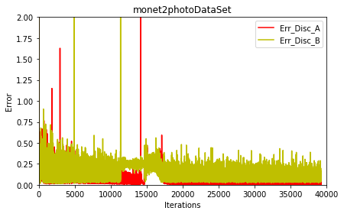
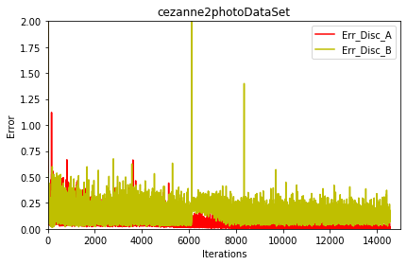
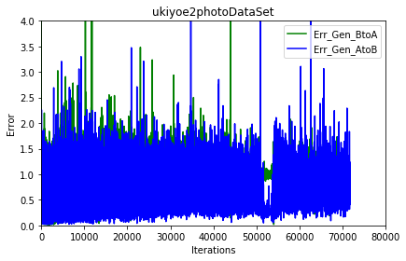
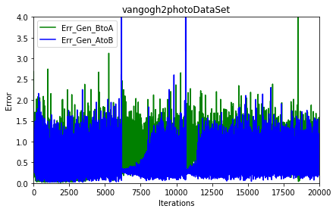
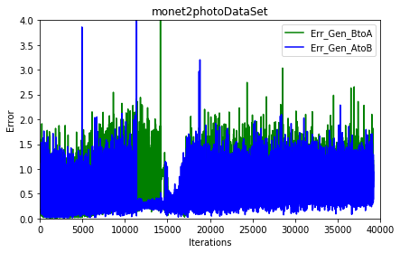
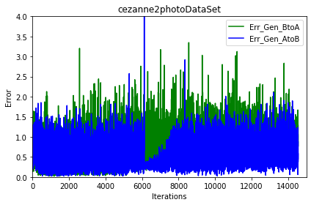
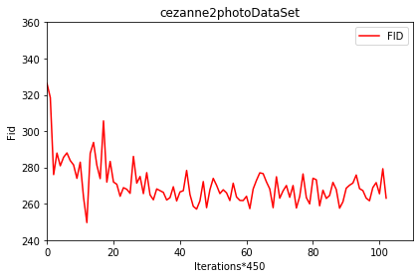
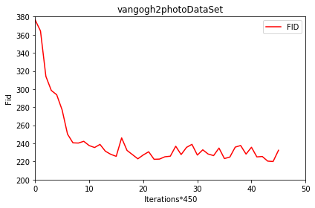
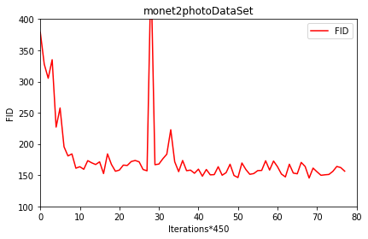
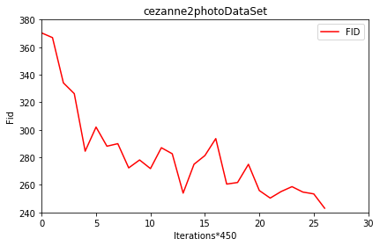
Results
real image Ukiyoe image Vangogh Image Monet image Cezanne Image

Slide 11
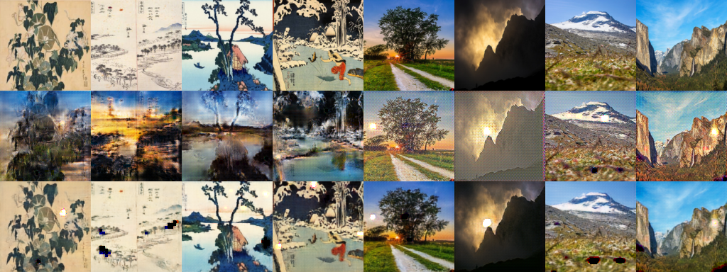
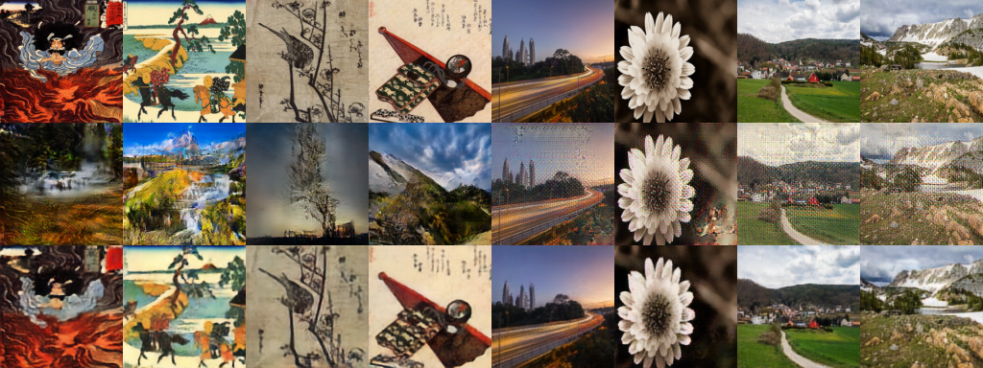
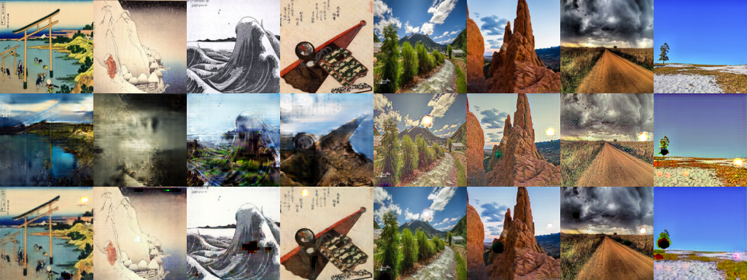
Results comparison: With and without Spectral Normalization and Self Attention
Without SN + SA
With SN + SA
Image generated at 230000 iteration
Image generated at 68500 iteration
Image generated at 238000 iteration
Ukiyoe2photo Dataset

Slide 12
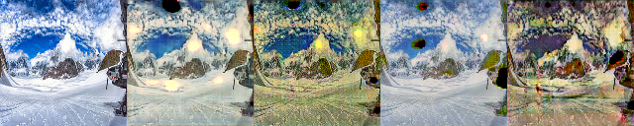
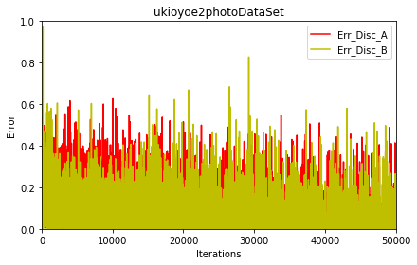
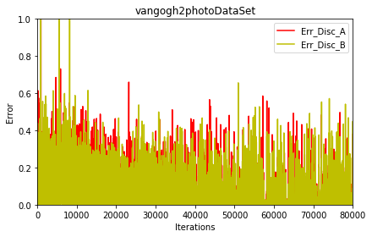
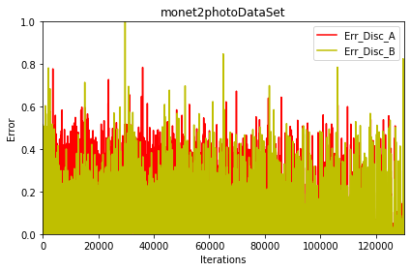
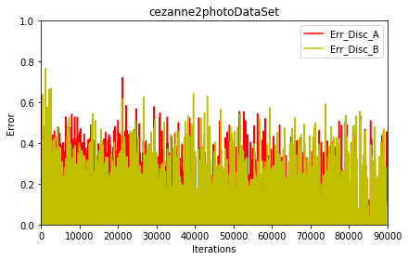
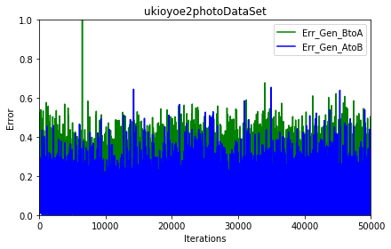
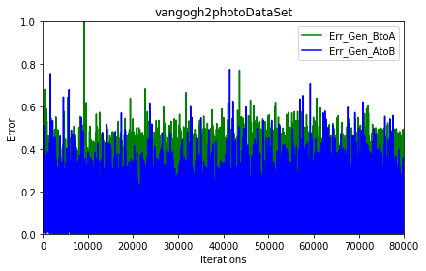
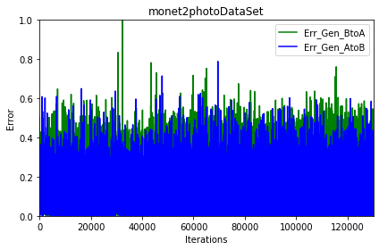
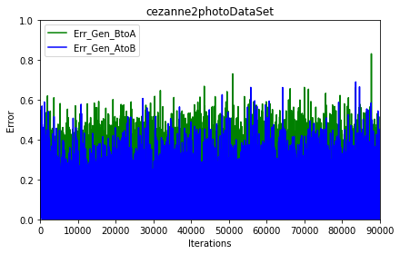
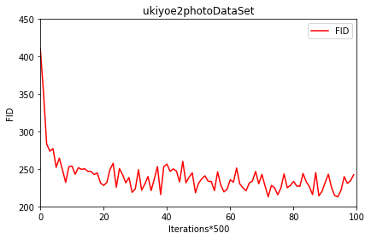
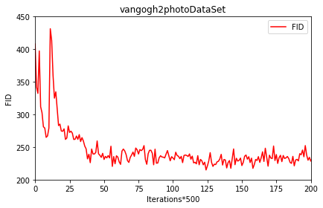
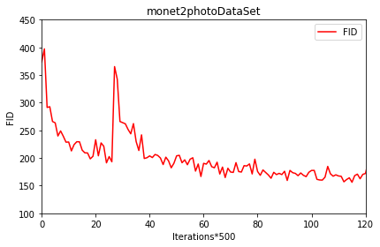
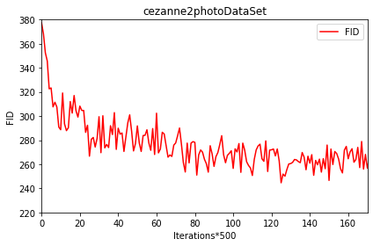
real image Ukiyoe image Vangogh Image Monet image Cezanne Image
Changes to Discriminator: Added two self attention modules: One attention module after fourth layer and another attention module after fifth layer

Slide 13
UNET Generator
32, 4x4, 1
3, 4x4, 32
64, 4x4, 32
32, 4x4, 64
128, 4x4,
64
64, 4x4, 128
256, 4x4, 128
128, 4x4, 256
output
Input
Tanh
BN&LR
BN &LR
BN& LR
BN &LR
BN & R
BN & R
BN & R
LR: LeakyRelu (0.2), R: Relu BN: Batch Normalization

Slide 14
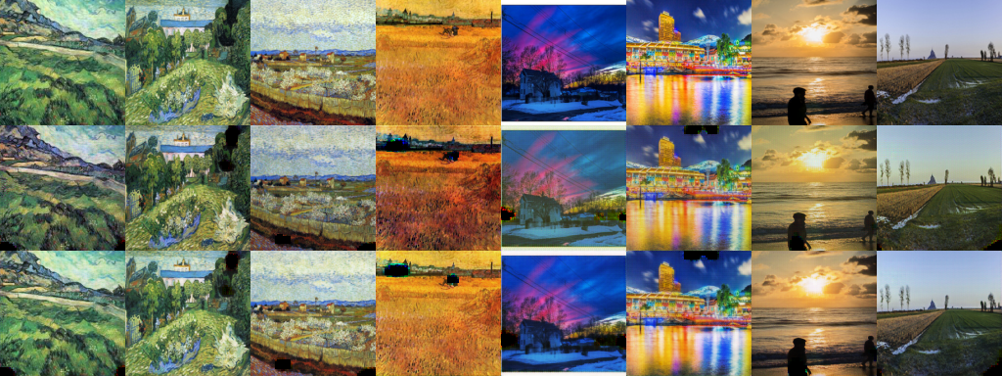
Results
Iteration 401000

Slide 15
References
“Unpaired Image-to-Image Translation using Cycle-Consistent Adversarial Networks”, Jun-Yan Zhu, Taesung Park, Phillip Isola, Alexei A. Efros, Berkeley AI Research (BAIR) laboratory, UC Berkeley, arXiv:1703.10593v6
Ian J. Goodfellow and Jean Pouget-Abadie and Mehdi Mirza and Bing Xu and David Warde-Farley and Sherjil Ozair and Aaron Courville and Yoshua Bengio, Generative Adversarial Networks, 2014.
Takeru Miyato and Toshiki Kataoka and Masanori Koyama and Yuichi Yoshida, Spectral Normalization for Generative Adversarial Networks, 2018.
Han Zhang and Ian Goodfellow and Dimitris Metaxas and Augustus Odena, Self-Attention Generative Adversarial Networks, 2018.
https://github.com/tjwei/GANotebooks/blob/master/CycleGAN-keras.ipynb

